Slide 1
Decentralized methods for Weapon-Target Assignment
Implementation of [1] by Landon Shumway
EE 682R – Multi-agent Systems
4/15/24
[1] K. Volle, J. Rogers, and K. Brink, “Decentralized Cooperative Control Methods for the Modified Weapon–Target Assignment Problem,” Journal of Guidance, Control, and Dynamics, Jul. 2016, doi: 10.2514/1.G001752.

Slide 2
Outline
Motivation of Problem
Background Literature
Set up
Methods
Results
Conclusion/Future Work/Questions

Slide 3
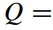
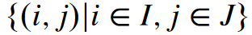
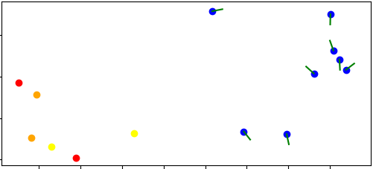
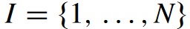
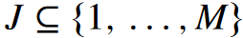
Motivation of Problem
Weapon-Target Assignment Problem
Set of mobile agents/weapons
Set of stationary targets
Find the optimal weapon-target pairing Q:

Slide 4
Background Literature
Paper implementation:
K. Volle, J. Rogers, and K. Brink, “Decentralized Cooperative Control Methods for the Modified Weapon–Target Assignment Problem,” Journal of Guidance, Control, and Dynamics, Jul. 2016, doi: 10.2514/1.G001752.
WTA first explored (linear approximation of nonlinear aspects):
A. S. Manne, “A Target-Assignment Problem,” Operations Research, vol. 6, no. 3, pp. 346–351, Jun. 1958, doi: 10.1287/opre.6.3.346.
Integer programming problem:
R. K. Ahuja, A. Kumar, K. C. Jha, and J. B. Orlin, “Exact and Heuristic Algorithms for the Weapon-Target Assignment Problem,” Operations Research, vol. 55, no. 6, pp. 1136–1146, Dec. 2007, doi: 10.1287/opre.1070.0440.
Game Theory:
G. Arslan, J. R. Marden, and J. S. Shamma, “Autonomous Vehicle-Target Assignment: A Game-Theoretical Formulation,” Journal of Dynamic Systems, Measurement, and Control, vol. 129, no. 5, pp. 584–596, Apr. 2007, doi: 10.1115/1.2766722.
A. Chapman, R. A. Micillo, R. Kota, and N. Jennings, “Decentralised Dynamic Task Allocation: A Practical Game–Theoretic Approach,” presented at the The Eighth International Conference on Autonomous Agents and Multiagent Systems (AAMAS ’09) (10/05/09 - 15/05/09), May 2009, pp. 915–922. Accessed: Apr. 10, 2024. [Online]. Available: https://eprints.soton.ac.uk/267066/
Simulated Annealing:
E. E. Witte, R. D. Chamberlain, and M. A. Franklin, “Task assignment by parallel simulated annealing,” in Proceedings., 1990 IEEE International Conference on Computer Design: VLSI in Computers and Processors, Sep. 1990, pp. 74–77. doi: 10.1109/ICCD.1990.130165.
S. Kirkpatrick, C. D. Gelatt, and M. P. Vecchi, “Optimization by Simulated Annealing,” Science, vol. 220, no. 4598, pp. 671–680, May 1983, doi: 10.1126/science.220.4598.671.
Hybrid Solutions:
Z.-J. Lee and W.-L. Lee, “A Hybrid Search Algorithm of Ant Colony Optimization and Genetic Algorithm Applied to Weapon-Target Assignment Problems,” in Intelligent Data Engineering and Automated Learning, J. Liu, Y. Cheung, and H. Yin, Eds., Berlin, Heidelberg: Springer, 2003, pp. 278–285. doi: 10.1007/978-3-540-45080-1-37.
M. Alighanbari and J. P. How, “Decentralized Task Assignment for Unmanned Aerial Vehicles,” in Proceedings of the 44th IEEE Conference on Decision and Control, Dec. 2005, pp. 5668–5673. doi: 10.1109/CDC.2005.1583066.
O. Shehory and S. Kraus, “Methods for task allocation via agent coalition formation,” Artificial Intelligence, vol. 101, no. 1, pp. 165–200, May 1998, doi: 10.1016/S0004-3702(98)00045-9.
Newer Methods:
J. Guo, G. Hu, Z. Guo, and M. Zhou, “Evaluation Model, Intelligent Assignment, and Cooperative Interception in Multimissile and Multitarget Engagement,” IEEE Transactions on Aerospace and Electronic Systems, vol. 58, no. 4, pp. 3104–3115, Aug. 2022, doi: 10.1109/TAES.2022.3144111.
B. Gaudet, K. Drozd, and R. Furfaro, “Deep Reinforcement Learning for Weapons to Targets Assignment in a Hypersonic strike.” arXiv, Oct. 27, 2023. doi: 10.48550/arXiv.2310.18509.

Slide 5
Novel Contribution
When defined as an optimization problem, there are many ways to define what “optimal” means
Most destroyed targets, most destroyed high-priority targets, etc.
This paper proposes three new cost functions (beyond the traditional cost function), that induce different behaviors depending on the goal of the scenario

Slide 6
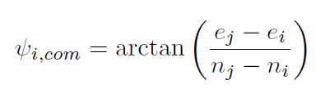
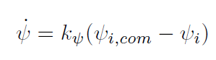
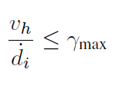
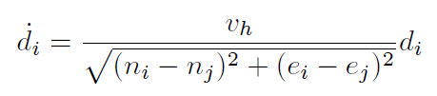
Set up – Agent Model
2DOF (constant velocity and altitude)
Commanded heading:
Control law:
Determining if a target is within range:

Slide 7
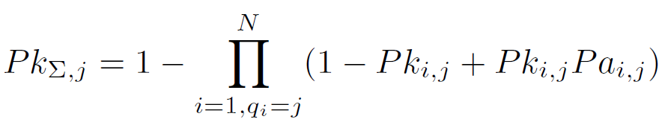
Set up – Target Kill Probability
Each target has a desired kill probability:
Calculated kill probability:
Weapon effectiveness of agent i
Probability that agent i gets attrited
Probability of agent i destroying target j

Slide 8
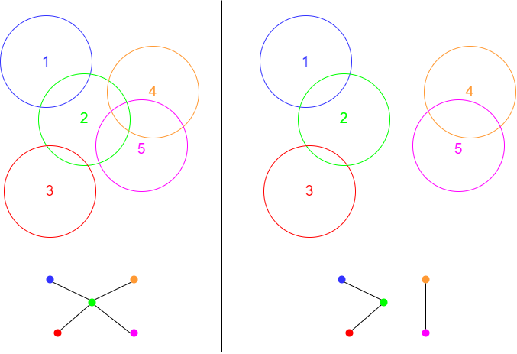
Set up - Communication
Agents select targets in a turn-based auction algorithm and broadcast their decision to all agents within its communication range
This decision gets re-broadcast in a daisy-chain network
Communication is assumed to occur much faster than decision-making rounds, which are assumed to be on a much shorter timescale than the arrival time from agents to targets
Each agent maintains a current “estimate” with the most up-to-date information it has on weapon-target pairs. It uses this estimate when deciding which target to pursue
Broken connections in the network result in out-of-date estimates
Not explicitly accounted for in the methods of this paper, but recognized

Slide 9
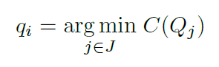
Set up - Optimization
Greedy search
Using its estimate of the current assignment set Q, each agent i selects the target j that minimizes some cost function the most:
Q_{j} is the resulting global assignment set if weapon i selects target j
Greedy search does not always find the optimal solution, but consistently finds a local minimum
Each agent uses its own estimate and executes its own greedy search, making this method fully decentralized

Slide 10
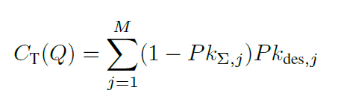
Set up – Traditional Cost Function
Cost function is the sum of the the probability that each target is not destroyed multiplied by its desired kill probability (“value” term)
The higher the calculated kill probability is, the smaller the resulting cost is
The desired kill probability weights the importance of each target
Problem: when there is a large disparity in target values, there is nothing stopping weapons from over-assigning a high-priority target even when its desired kill probability has already been reached
Waste of weapon resources

Slide 11
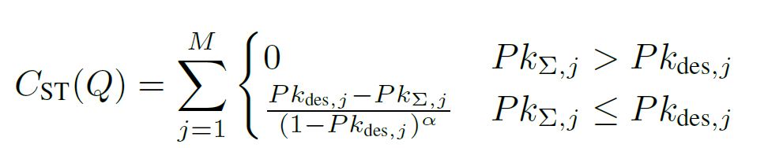
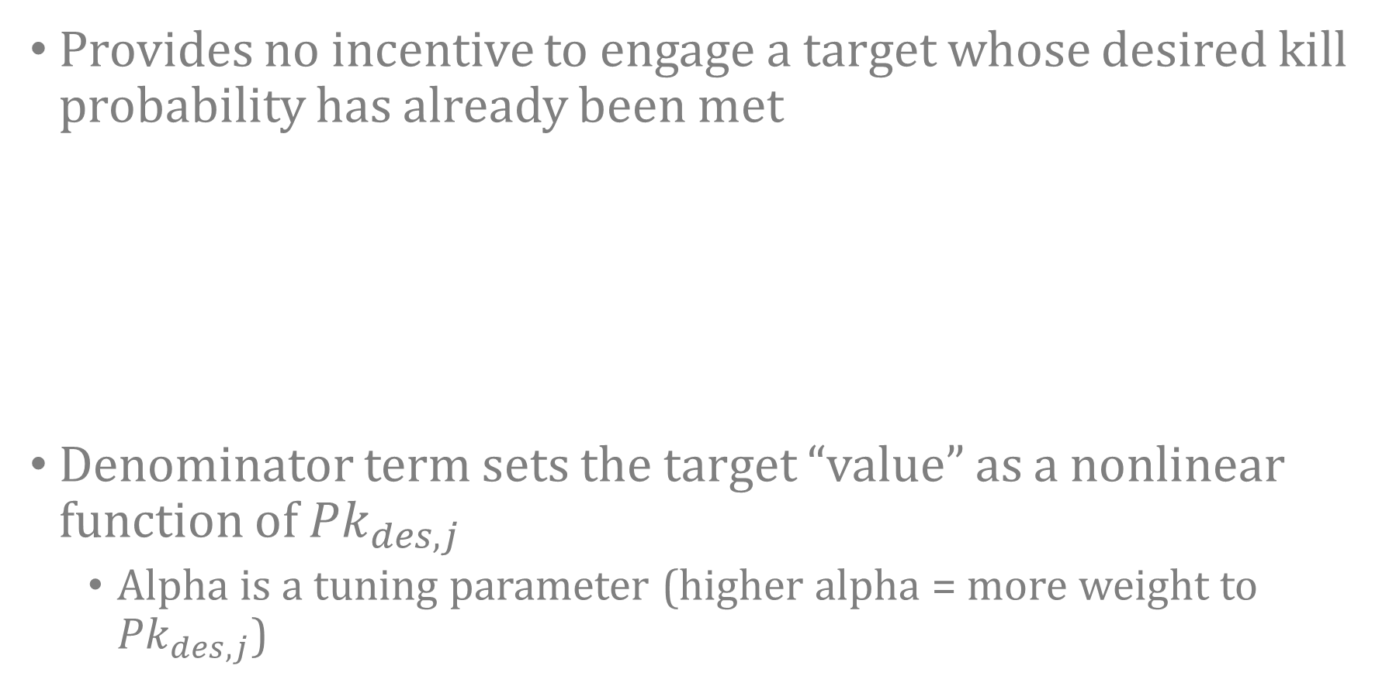
Methods – Sufficiency Threshold CF
Provides no incentive to engage a target whose desired kill probability has already been met
Denominator term sets the target “value” as a nonlinear function of ${Pk}_{des, j}$
Alpha is a tuning parameter (higher alpha = more weight to ${Pk}_{des, j}$)

Slide 12
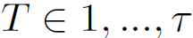
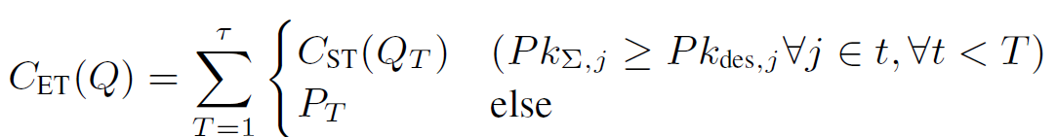
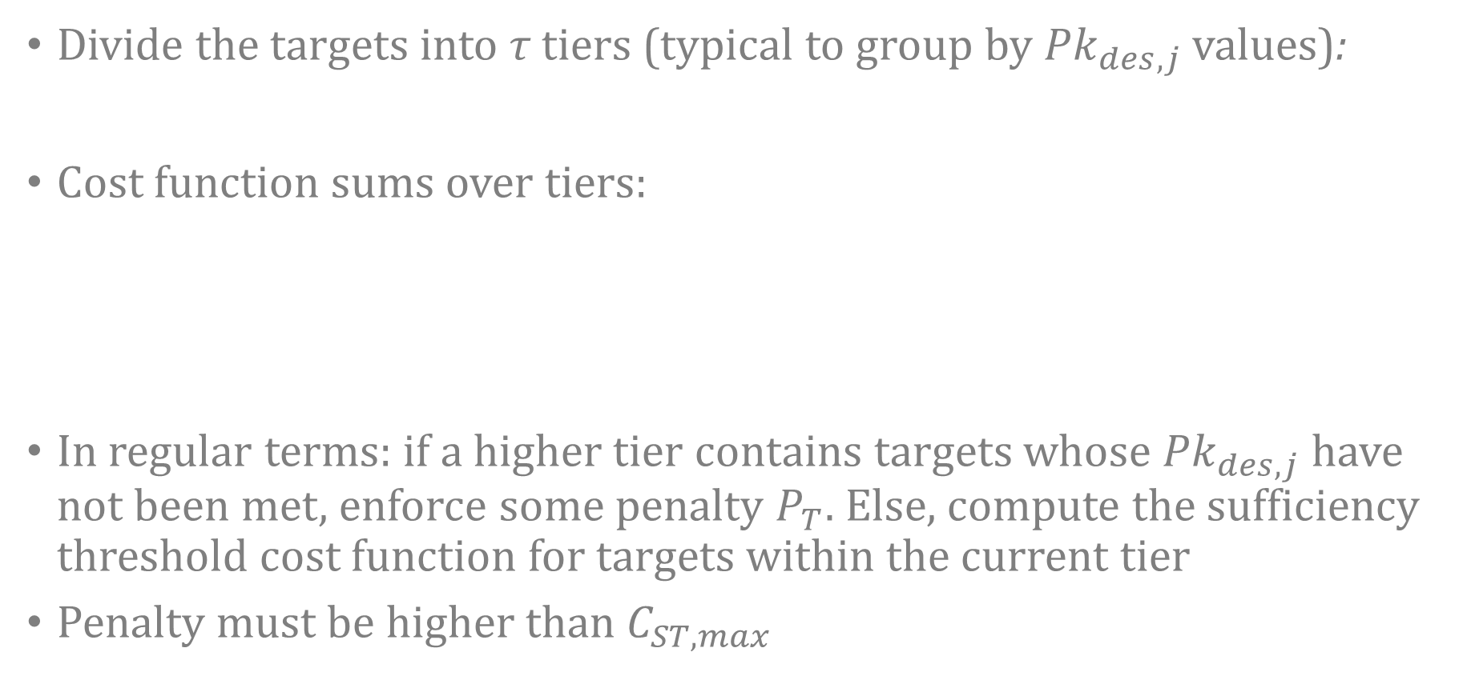
Methods – Enforced Tiering CF
Divide the targets into τ tiers (typical to group by ${Pk}_{des, j}$ values):
Cost function sums over tiers:
In regular terms: if a higher tier contains targets whose ${Pk}_{des, j}$ have not been met, enforce some penalty $P_{T}$. Else, compute the sufficiency threshold cost function for targets within the current tier
Penalty must be higher than $C_{ST, max}$
Lower value for T denotes a higher priority tier

Slide 13
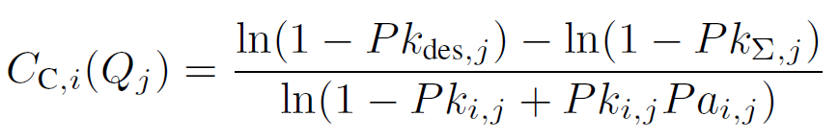
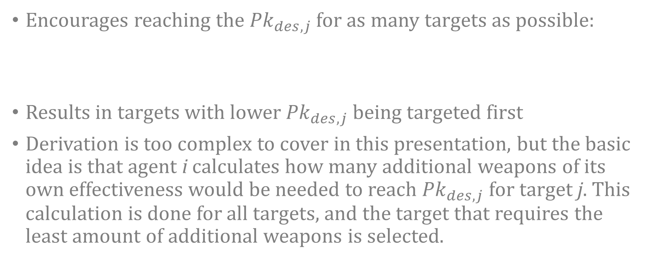
Methods – Completion CF
Encourages reaching the ${Pk}_{des, j}$ for as many targets as possible:
Results in targets with lower ${Pk}_{des, j}$ being targeted first
Derivation is too complex to cover in this presentation, but the basic idea is that agent i calculates how many additional weapons of its own effectiveness would be needed to reach ${Pk}_{des, j}$ for target j. This calculation is done for all targets, and the target that requires the least amount of additional weapons is selected.

Slide 14
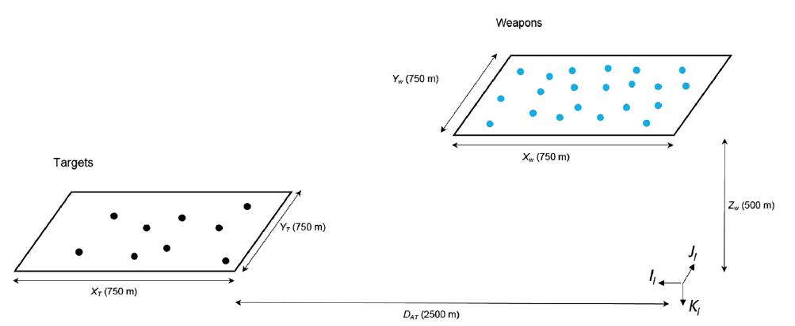
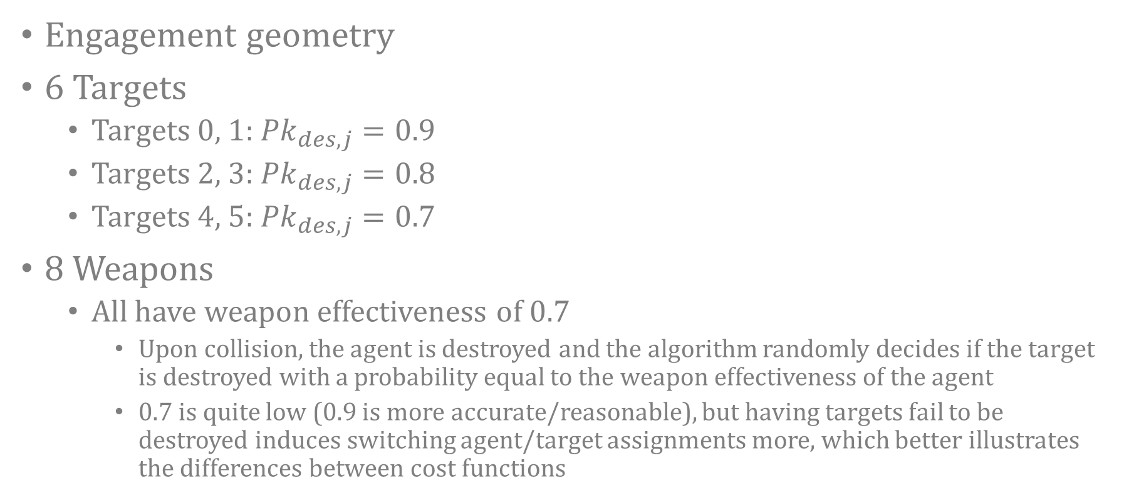
Results – Scenario
Engagement geometry
6 Targets
Targets 0, 1: ${Pk}_{des, j}=0.9$
Targets 2, 3: ${Pk}_{des, j}=0.8$
Targets 4, 5: ${Pk}_{des, j}=0.7$
8 Weapons
All have weapon effectiveness of 0.7
Upon collision, the agent is destroyed and the algorithm randomly decides if the target is destroyed with a probability equal to the weapon effectiveness of the agent
0.7 is quite low (0.9 is more accurate/reasonable), but having targets fail to be destroyed induces switching agent/target assignments more, which better illustrates the differences between cost functions

Slide 15
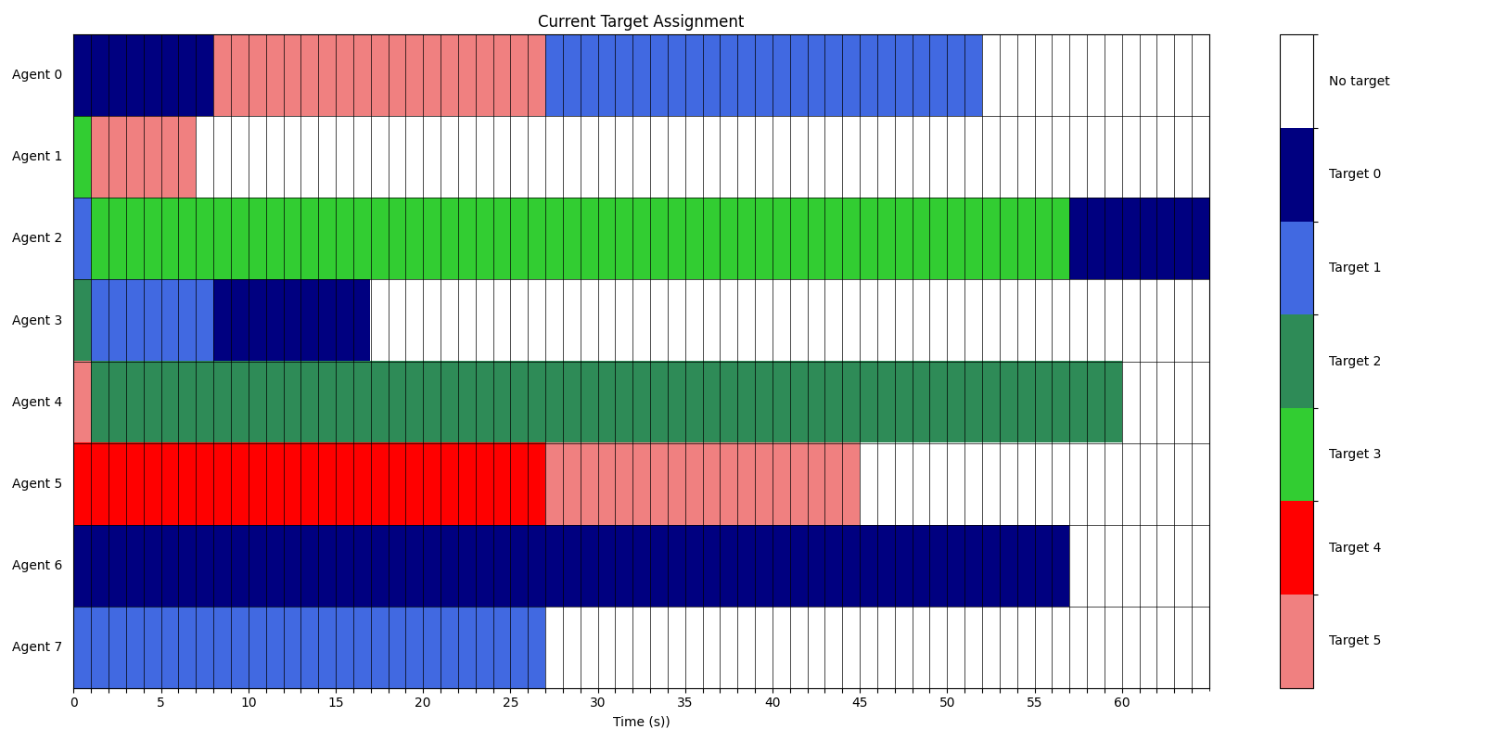
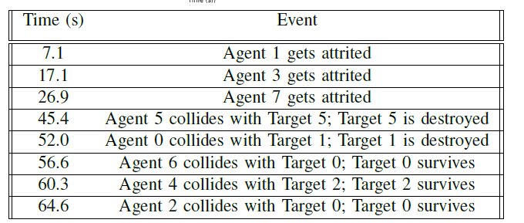
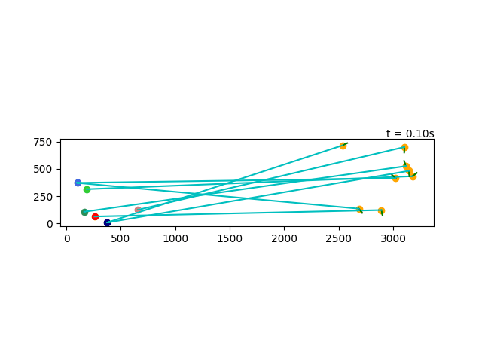
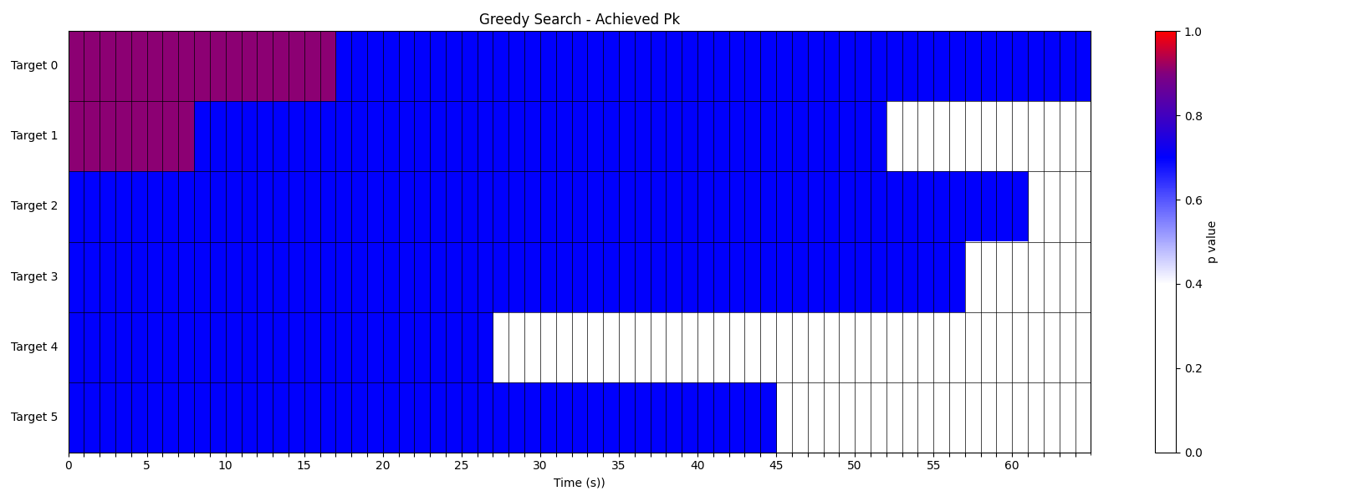
Results – Traditional CF

Slide 16
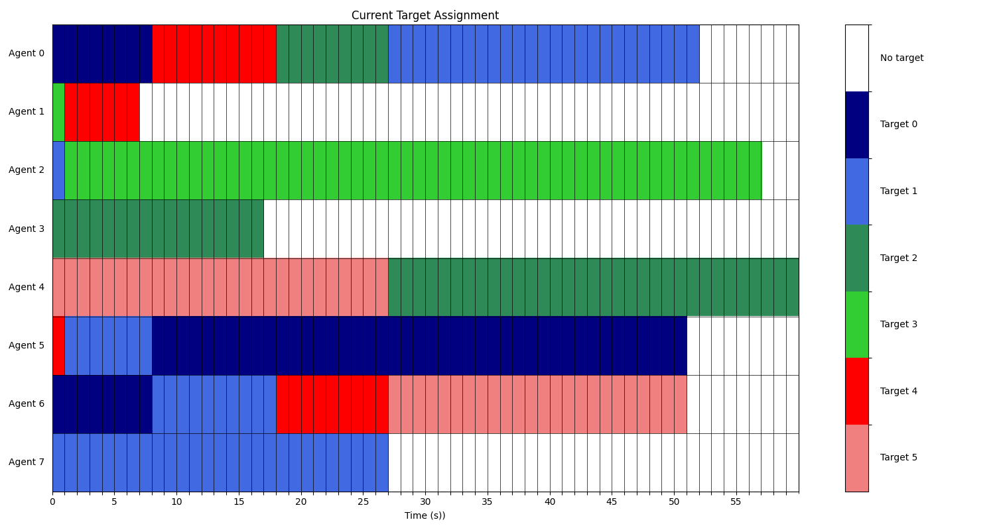
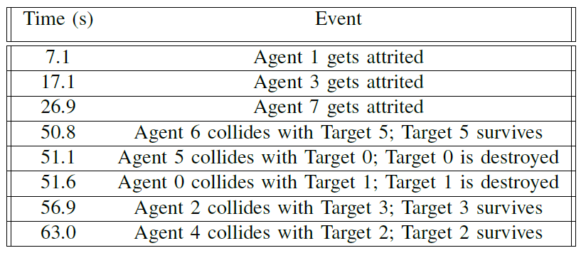
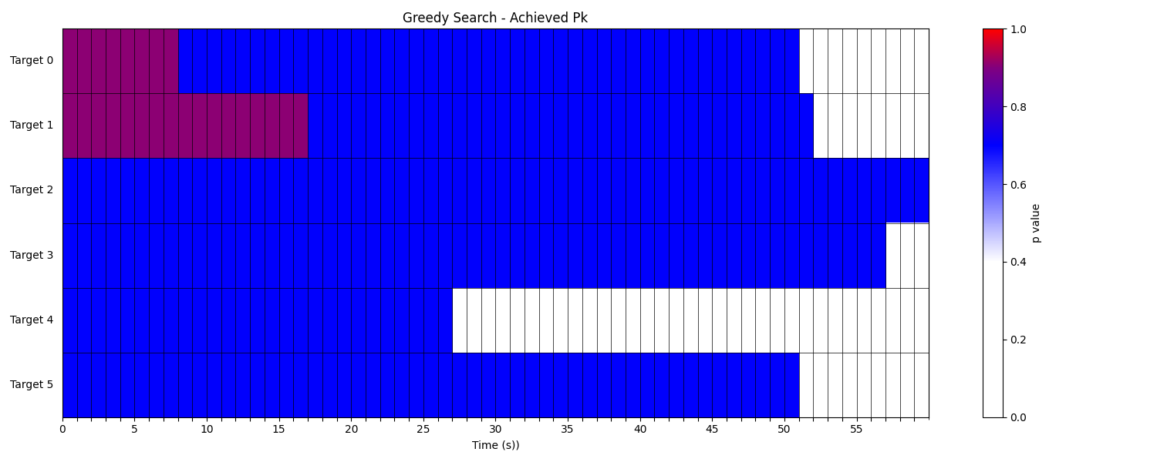
Results – Sufficiency Threshold CF

Slide 17
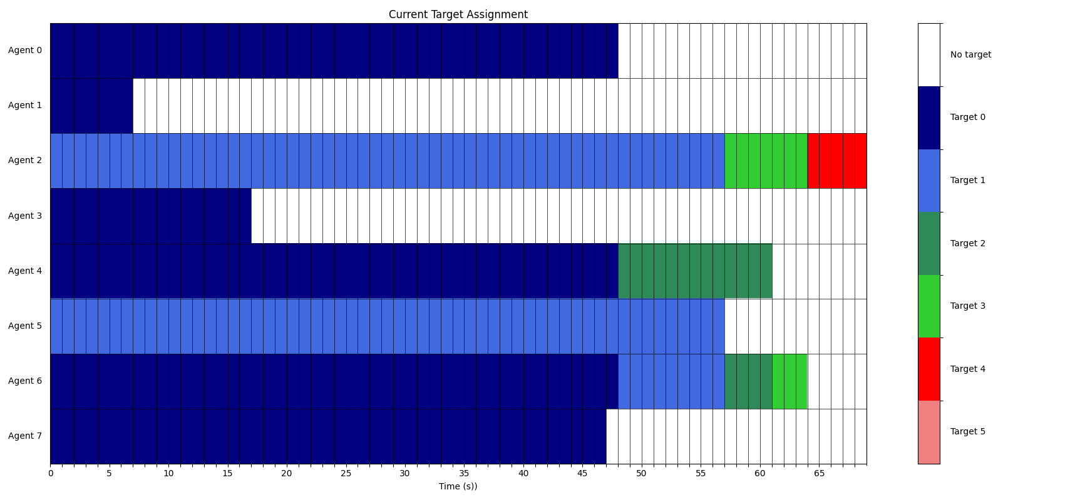
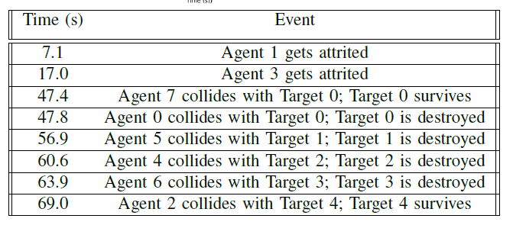
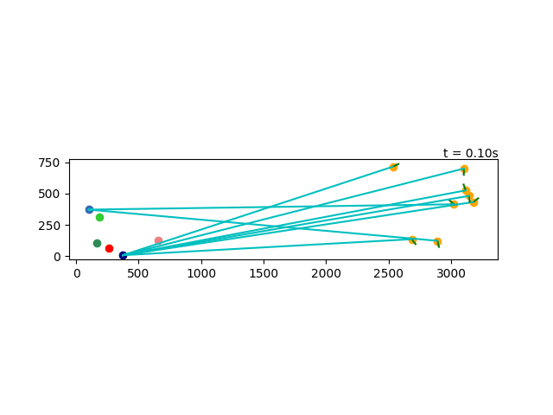
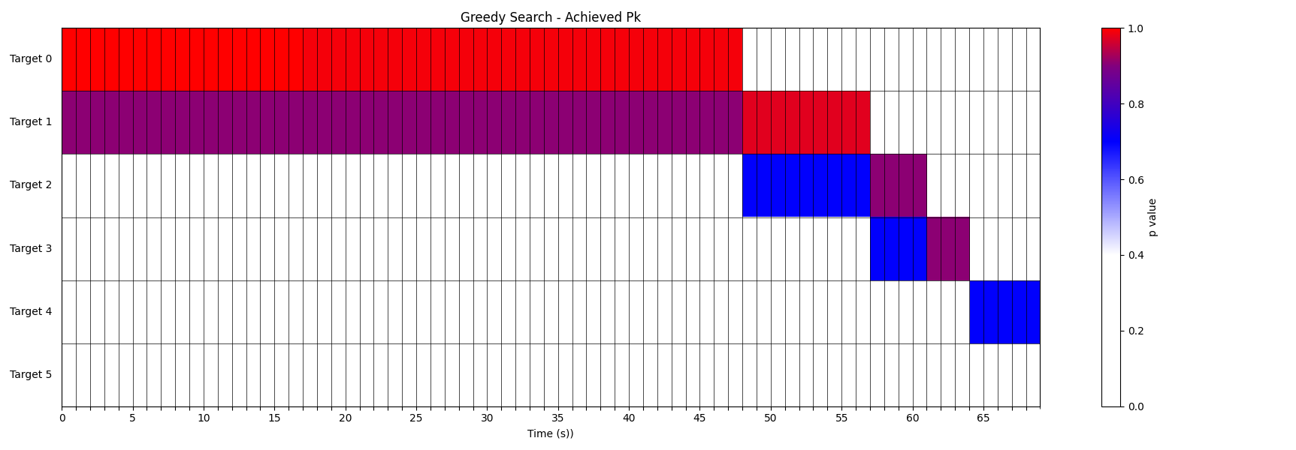
Results – Enforced Tiering CF

Slide 18
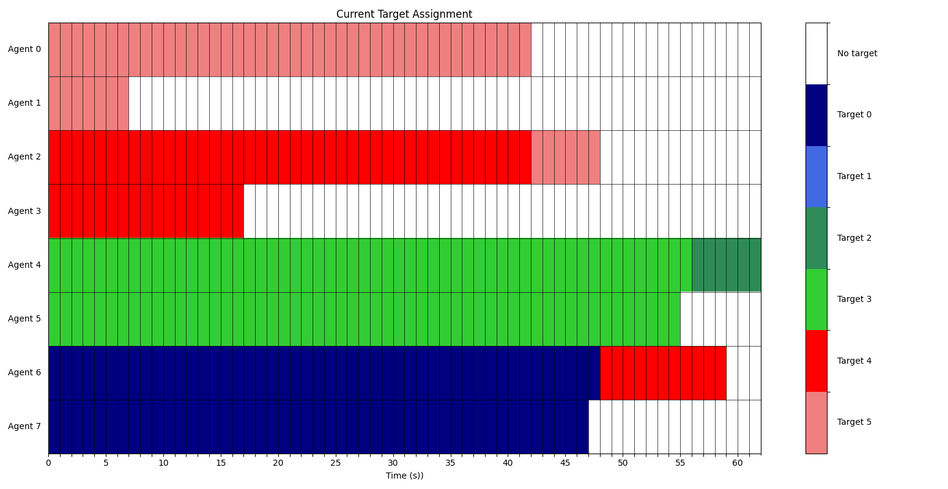
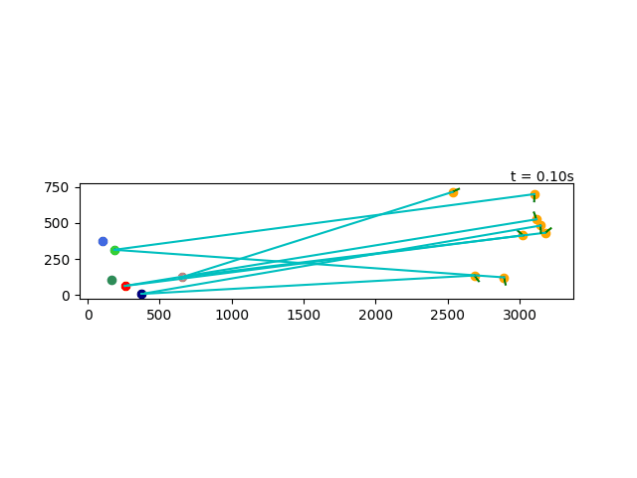
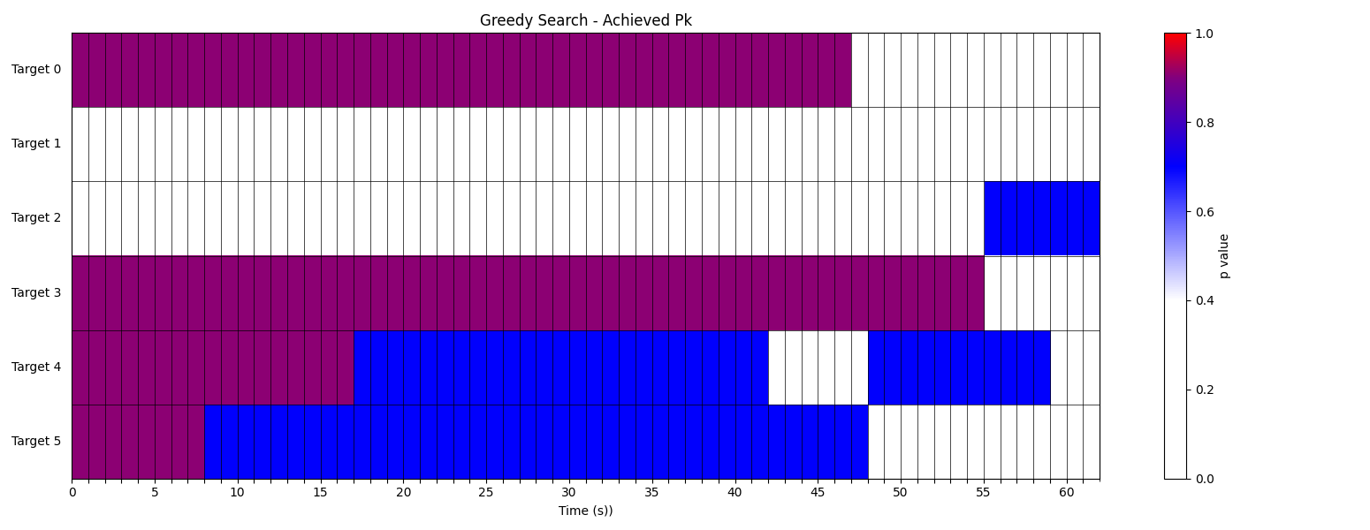
Results – Completion CF

Slide 19
Conclusion/Future Work
These three novel cost functions induce different behaviors in target assignment as expected and work reliably within the decentralized framework of the problem
Future Work
Implement in 3D simulation environment
3DOF and 6DOF dynamics models
Midcourse/terminal phase guidance laws
Defending agents replace random attrition
Methods for estimating attrition probability and weapons effectiveness
Questions?

